Slide 1

GAME DEV WITH ALLEGRO 5
Window Event

Slide 2
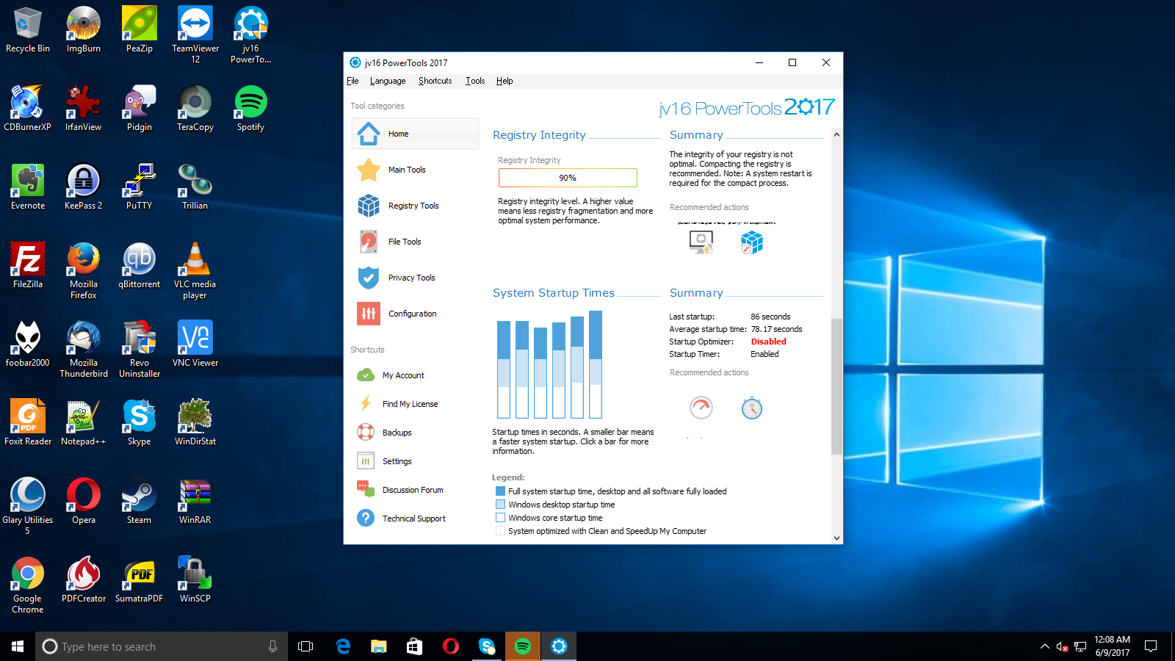
What is a Window Event?
An action you take or an occurrence from the window that is recognized by the software
What does a window contain
X button
Minimize/Maximize button
Minimize/Restore button

Slide 3
How to implement a Window Event?
Outside of the game loop
First you need declare an Event Queue
ALLEGRO_EVENT_QUEUE *[name] = al_create_event_queue()
Second you need to register an event source
al_register_event_source([name of the ALLEGRO_EVENT_QUEUE], al_get_display_event_source([name of ALLEGRO_DISPLAY]))
Inside of the game loop
You declare an event
ALLEGRO_EVENT [name]
Put in a function that waits for an event to be pressed
al_wait_for_event([name of the ALLEGRO_EVENT_QUEUE], &[name of the ALLEGRO_EVENT])
If statement
if([name of ALLEGRO_EVENT].type == ALLEGRO_EVENT_DISPLAY_CLOSE)
break the loop
After the game loop
al_destroy_display([name of ALLEGRO_DISPLAY])
al_destroy_event_queue([name of the ALLEGRO_EVENT_QUEUE])

